Slide 1
Diseñar y llevar a cabo reuniones efectivas

Slide 2
Agenda
Presentación- 5 min
EJERCICIO: Mejor/peor reunión- 30 min
Facilitación y roles en la reunión – 15 min
DESCANSO- 10 min
La Agenda: Historia de una buena reunión – 15 min
EJERCICIO: Actuación de roles – 30 min
Herramientas – 10 min
Cierre - 5 min

Slide 3
Workshop Goal
Preparar a las trabajadoras/es dueñas/os para planificar, ejecutar y participar en reuniones fluidas, efectivas y energizantes.

Slide 4
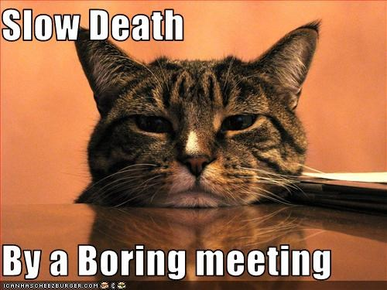
¿Por qué hablar de reuniones?
Muerte lenta
a causa de una reunión aburrida
Notes:
Why are we here? Why spend so much time talking about meeting?
Because you're about to spend a lot more time in meetings. There is nothing worse than a bad meeting.
The meeting is a worksite: a good meeting is not sitting around, or taking a break from work. It is the work, and should be honored as such.

Slide 5
Expectativas
¿Qué quiere llevarse hoy con usted cuando termine esta capacitación?
Notes:
Write down responses on the board, and check in with group at the end of workshop to make sure we covered all our bases

Slide 6
Ejercicio Mejor/Peor Reunión
Comparta sobre una reuníon fluída o frustrante, incluya:
  a. ¿Cuál era el propósito de la reunión?
  b. ¿Qué aprendió de su experiencia?
  c. ¿Qué clase de reuniones le gustaría tener aquí ?
Monitoreo de tiempo: 3 minutos cada persona
Quien toma notas: puntos claves, enfóquese en aprender
Notes:
Leave up
Ask participants to form groups of five people.
Each small group will need to have one writing utensil, notebook paper, and a timing device (phone, watch). Establish a timekeeper and a note taker.
Each participant will have 3 minutes to share a time when a meeting went smoothly or a time when they found a meeting frustrating. The timekeeper will time 3 minutes each, keeping the group on schedule while the note taker jots down key points, focusing on what was learned from each experience and what each participant would like to see. Please include the following details in your sharing (write on flipchart paper):
What the purpose of the meeting was
What you learned from your experience
What kind of meetings you would like to have here at the New School
(15 min)
Note taker will read back what was captured, while participants’ confirm/edit/add to include all relevant information.
(2 min)
In the whole group ask participants to share responses by brainstorming a list of best meeting practices from what they learned in their small groups →Categories for flip charts: Agenda and Roles
(13 min)
n overhead throughout exercise section

Slide 7
Lluvia de ideas
Agenda
Roles
Propósito
Facilitador
Estructura
Participante
Preparación
Monitorear el tiempo
Cumplir
Reunión Efectiva
Notes:
Have a piece of flip chart paper titled with each of the above: Agenda and Roles (Anything falling under preparation, purpose, follow through should be listed under Agenda. Anything falling under specific meeting roles and community agreements should be listed under Roles)

Slide 8






Roles de la reunión
Facilitador
Participante
Toma notas
Monitorea tiempo
Persona responsable
?
Notes:
Start and end with the Facilitator to emphasize importance. Introduce the role, and then finish the slide with a deeper dive.
Facilitator
The facilitator keeps the discussion and decision-making process moving along. The facilitator takes responsibility for the process, but should be limitedly involved in the content of the meeting. They make sure everyone is heard and the discussion is productive. They are some combination of cheerleader, police, and weaver.
What is Facilitation?
Facilitation insures that the group is empowered as a whole
Makes sure that everyone gets to participate and share ideas in a meeting, not just those that feel most comfortable speaking up.
Works to prevent or interrupt any attempts by individuals or groups to overpower the group as a whole
Helps the group come to the decisions that are best for the organization/whole group. What is best for the group rather then a personal preference?
Ensures the group follows its own agreed upon process and meeting agreements
A power that is delegated by the cooperative to the facilitator with explicit permission to use whatever tools will help achieve the outcome.
Participant
An effective meeting is not the sole responsibility of the facilitator. Participants can make a good meeting great.
Shared Leadership
We all have responsibilities
Show up prepared by reading all supporting documents in advance and going over the agenda
Do not talk more then you need to
Follow through with what is expected of you
Have the self-confidence to know that what you think is important enough to share (most of the time)
Point Person
The point person (PP) introduces and leads the discussion on their agenda item/s. May be multiple point people in a meeting.
Time keeper
The timekeeper reminds the facilitator when time is almost up for a given item. A stopwatch or timer is invaluable.
Note taker
The Note Taker takes notes on paper, laptop and/or on a flip chart. Meeting notes should be distributed as soon after the meeting as possible. The longer the lag, the less confidence the members have that their investment will result in action. For groups that meet regularly, the Note Taker is responsible for keeping previous meeting notes and agendas in one place where they can be referenced later, such as through a shared network drive or a notebook, etc.

Slide 9


Trucos de facilitación
(Herramientas y Técnicas )
Notes:
Include the participants by asking them what their success factors are- brainstorm and write it down on flip chart paper
Tools (Pick a handful of your favorites to share, and hold the others to reply to people’s direct question/experience)
Start the meeting with quick check-ins on how people are doing so you know where everyone is at when they walk in the room
Start an item off with conversation in pairs or small groups before coming back to the whole group. Often you will get deeper this way and end up with better, more creative ideas.
Do a round robin/go-around to hear from everyone. (People can always pass if they want)
When lots of people want to talk, take "stack" meaning the facilitator takes a list of up to 5 at a time to speak to a discussion item. This way people do not have to keep their hands raised or interrupt each other
Focus on outcome of the meeting during the design process, because not all meetings are the same. What is the purpose of this meeting?
Arrange (before the meeting) to have somebody else present each item (Point Person).
Be suspicious of agreements reached too easily - test to make sure that people really do agree on essential points.
Encourage people to think of fresh solutions as well as to look for possible compromises.

Slide 10
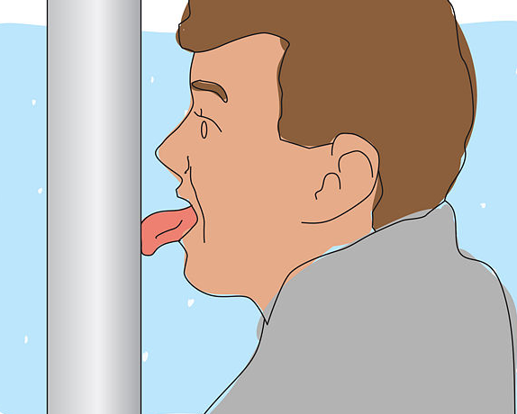
Dificultades de la facilitación
¿Estancada?
¿Cometió un error?
¿Toque de atención?
(alarma)
Notes:
Include the participants by asking them to share their mistakes and what they learned from it- write it down on flip chart paper
Rushing the group (Sometimes going slower takes less time in the long run)
Becoming inflexible or unwilling to adapt the agenda/plan to meet the group’s evolving needs.
Forgetting to get additional support
Co-facilitator
Note taker, logistics coordinator
Meeting for too long without food, water and/or breaks
Red flags and dynamics to watch out for
People interrupting each other or the facilitator
Tone and body language: Do people look upset? Checked out? Bored? Angry? If you see this check in with the group or the individual
Individuals monopolizing conversation
Back-and-forth between individuals
What to do when you get stuck
Use the agenda and expected actions
Take a break
Ask questions to initiate discussion, as opposed to jumping directly into concerns.
When people are voicing concerns, ask them what can be done to meet their concerns
Listen for agreement and note it
Break big decisions down into smaller decisions
Don’t allow back-and -forth between two participants to dominate a discussion or agenda item: ask for input from others.
In tense situations or when solutions are hard to reach, remember humor, affirmation, quick games for energy change of places, small buzz groups, silence, etc.

Slide 11
Resumen de Facilitación
Apertura
Cierre
Enmarcar
Evaluación
Establecer reglas del juego
Manejo del tiempo

Slide 12
Planificar su Reunión
Preguntas preliminares
¿Es necesaria una reunión?
¿Cuál es el propósito principal de la reunión?
Propósito: ¿se puede decir en una frase u oración para guiar la planificación?
¿Qué queremos lograr?
¿Quién debe estar ahí para lograrlo?
¿Espacio físico y materiales para llevar a cabo la reunión?
¿Es un buen momento para tener la reunión?
¿Es necesaria una reunión?
Notes:
To be Brainstormed with the group, but can use these as prompting questions if needed.

Slide 13

La Agenda:
Historia de una buena reunión
Agenda
Notes:
Go through the sample agenda handout at this slide or refer to it

Slide 14
How to create an agenda?
The Agenda
always includes…
  Tema/Nombre del asunto
  Etiquete los asuntos con la acción o resultado esperado
  Tiempo
  Persona responsable
  Cualquier documentación de apoyo
Notes:
Discuss handout

Slide 15



La agenda tiene amistades
Acuerdos Comunitarios
Siguientes pasos
Temas para reuniones futuras

Slide 16
Community Agreements
  Diva uno, un micrófono, por favor una persona habla a la vez
  Sea curiosa/o, tomamos mejores decisiones cuando abordamos nuestros problemas y desafíos con preguntas y curiosidad. Dele espacio a la curiosidad y a los pensamientos creativos
  Nadie sabe todo; juntas sabemos mucho, todas tenemos la oportunidad de practicar la humildad, porque tenemos algo que aprender de los demás en el aula. Eso significa que todas las personas tenemos la responsabilidad de compartir lo que sabemos para que otras personas aprendan de nosotras
  Paso adelante, Paso atrás motive a los que no hablan mucho para que hablen y a los que hablan mucho para que hablen menos
  No podemos articular todo lo que pensamos todo el tiempo, muy a menudo la gente se siente temerosa de participar en una capacitación o reunión por miedo a “equivocarse” o a tropezarse con sus propias palabras. Queremos que toda persona se sienta cómoda participando, incluso si no puede articular sus pensamientos tanto como quisiera
  Tenga conciencia del tiempo, esto le ayuda a su facilitadora/or, y ayuda a respetar el tiempo y compromiso de la gente. Por favor regrese de los descansos a tiempo, y evite hablar en monólogos largos
Notes:
This should be copied to flip chart paper prior to workshop, and hung in a visible place

Slide 17
Trama: Planear su reunión
Consideraciones sobre la secuencia de una Agenda
  Clima de aprendizaje
  Anuncios
  Victorias fáciles
  Cosa grandes
  Final corto y fácil

Slide 18

Conclusión: Lecciones aprendidas aka Mejores prácticas
Proceso de Comunicación de la Agenda
  Establecer la fecha y la hora
  Pida temas para la agenda
  Publique la agenda y los documentos de apoyo Email, Google Doc, papel, poster
Tenga un proceso y un formato
Notes:
Call for agenda items in advance of the meeting by X days with a window for submission.
Have a clear process for getting items on the agenda and a format for submitting them.
Publish agenda and supporting docs in advance of the meeting by X days.
This can look like a Google Doc or over email

Slide 19
Conclusión: Lecciones aprendidas aka Mejores prácticas
Cumpla y haga seguimiento
Registre toda las tareas (quién, qué, cuándo, prioridades)
Registre todas las decisiones
Comience y termine cada reunión revisando las acciones y los compromisos de las participantes
TAREA: Ariel. Investigar nuevos proveedores de materiales de limpieza . Traer resultados a la reunión del 24/9.
DECISIÓN: Cambio de horas de operación de L-V 7am-4pm. Effective 1/10.
TEMA PARA EL FUTURO: Política de vacaciones.
Notes:
(some coops take verbatim minutes, others take minimum minutes).
Determine your needs and reasons, and build a notes format around that.

Slide 20

Conclusión: Lecciones aprendidas aka Mejores prácticas
¿Me puede dar retroalimentación? ¿Qué tal estuvo la reunión ?
¡Magnífico! ¡Logramos hacer muchas cosas !

Slide 21
Actuación de Roles
En grupos de 10 personas lea el propósito de la reunión
Establezca roles (no comparta su rol si no es uno de estos tres a continuación)
  Facilitadora
  Monitoreo de tiempo
  Tomar notas
Plan (10 min)
Actuación de roles escenario de reunión (10 min)
Reporte sobre la experiencia con todo el grupo (10 min)
Notes:
Leave up on overhead throughout exercise section

Slide 22
Herramientas
¿Qué herramientas hemos utilizado hoy para incrementar la participación y hacer que las reuniones sean interesantes?
Notes:
Brainstorm with group
Introduction Exercises
Listening
Handout
Content and Process
What the group is talking about- the content
How the group talks about the subject- the process
Agenda Building

Slide 23

Cierre
¿Les importaría llenar un formulario de evaluación del taller?
Notes:
Quick re-cap. → a lot of information, how are people feeling about it? It’s go to be digesting int.
Final questions
Evaluation
Thank you!

